Slide 1
IST687 – Applied Data Science
Sample in a Jar

Slide 2
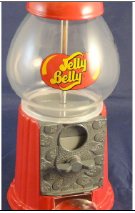
Data Science
Sample in a Jar
Sampling distributions are the conceptual key to statistical inference. Many approaches to understanding sampling distributions use examples of drawing marbles or gumballs from a large jar to illustrate the influence of randomness on sampling. Using the list of U.S. states illustrates how a non-normal distribution nonetheless has a normal sampling distribution of means.

Slide 3
Data Science
Chapter Objectives
Creating and interpreting sampling distributions
Understanding the effects of randomness
Discussion and demonstration of "the law of large numbers" and " the central limit theorem"
Review of inferential statistics vs. descriptive statistics
Delineation of standard deviation vs. standard error
Demonstration of R functions to facilitate sample sizes, replication, interpretation of results, and visualization via histogram

Slide 4
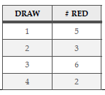
Data Science
Red gum balls, blue gum balls
Same ratio of each in a jar
Draw a sample of 8 (one draw)
What mix of red and blue gum balls will we get with one draw → Really don’t know
Forces of “randomness” driving uncertainty
“long run test” → multiple draws

Slide 5
Data Science
“drawing” process
Population (gum balls)
Sample
Distribution
Use “R” to draw samples
sample(USstatePops$april10census, size=16, replace=TRUE)
12702379 19378102 8791894 19378102 9535483 6346105 4533372 5029196 25145561 6392017 19378102 6483802 8001024 8001024 12830632 814180
Use “R” to calculate mean of the sample
mean(sample(USstatePops$april10census, size=16, replace=TRUE))
5513472

Slide 6
Data Science
Not interested in one sample but what happens over time, ie many samples
Replication
replicate(4,mean(sample(USstatePops$april10census,size=16,replace=TRUE)),simplify=TRUE)
5234752 5978035 5876217 4222350

Slide 7
Data Science
mean(replicate(400,mean(sample( USstatePops$april10census, size=16, replace=TRUE)), simplify=TRUE))
6014258
Interpretation
Draw 400 samples of size 16 from our state population
Calculate the mean from each sample and keep it in a list,
Calculate the mean of the 400 sample means
Calculated mean of means is off by 39,577
6,053,835 (mean of 51 states) – 6,014,258 (mean of means) = 39,577
39,577 / 6,053,835 = .65% error

Slide 8
Data Science
mean(replicate(4000,mean(sample(USstatePops$april10census,size=16,replace=TRUE)), simplify=TRUE))
6053534
6,053,835 (mean of 51 states) – 6,053,534 (mean of means) = 301
Display distribution of 4000 means via a histogram as frequencies
hist(replicate(4000,mean(sample(USstatePops$april10census,size=16,replace=TRUE)),simplify=TRUE))

Slide 9
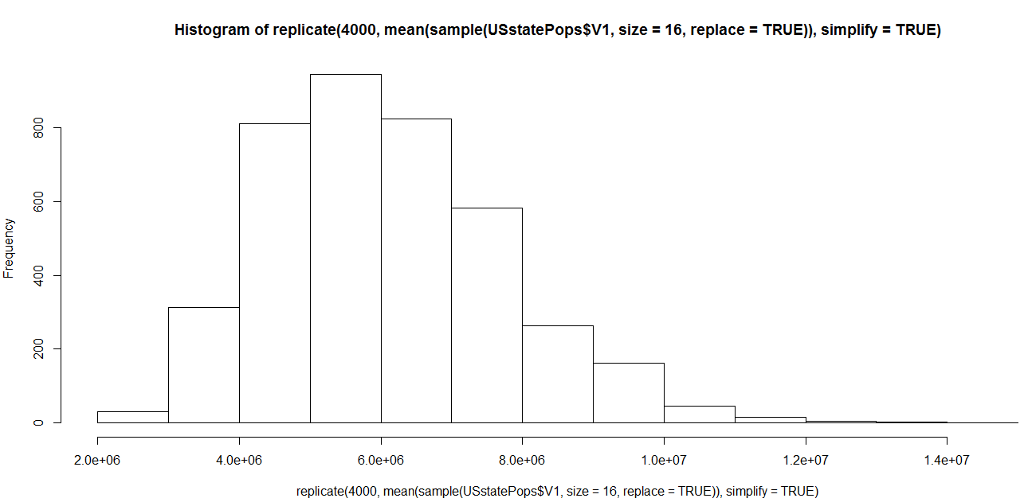
Data Science

Slide 10
Data Science
Law of Large Numbers
If you run a statistical process a large number of times, it will converge on a stable result
Central Limit theorem
When we look at sample means and take into account the “Law of Large Numbers”, the distribution of sampling means starts to create a bell-shaped or normal distribution, and the center of that distribution, the mean of the sample means gets close to the population mean

Slide 11
Data Science
Sampling Distribution
Save one distribution sample
SampleMeans <-replicate(10000, mean(sample(USstatePops$april10census, size=120, replace=TRUE)), simplfy=TRUE)
Length(SampleMeans)
10000
mean(SampleMeans)
6058734
Histogram
Hist(SampleMeans)

Slide 12
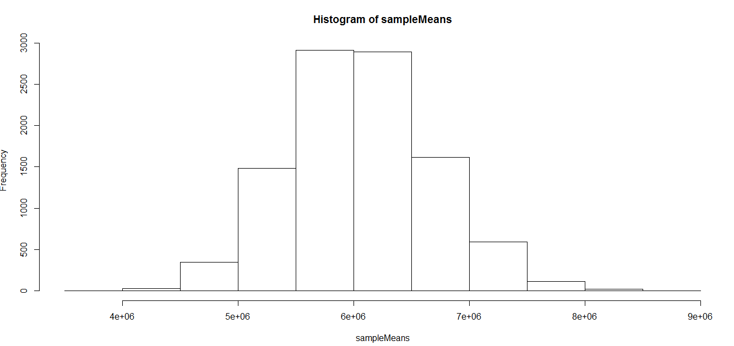
Data Science

Slide 13

Data Science
Sampling Distribution
Summary(SampleMeans)
Interpretation
Min vs mean
Max vs mean
Median vs mean
Quartiles

Slide 14
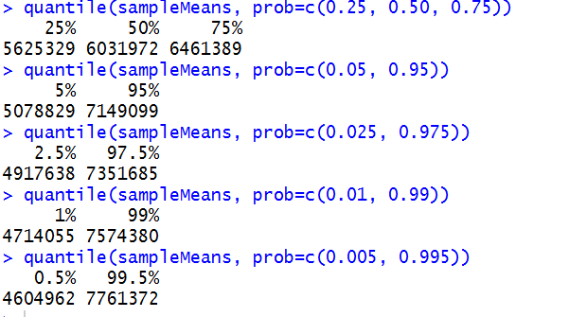
Data Science
Sampling Distribution
Quantile function, similar to summary function

Slide 15
Data Science
MysterySample
> MysterySample <- c(3706690, 159358, 106405, 55519, 53883)
> mean(MysterySample)
816731

Slide 16
Data Science
MysterySample – sample of US states or something else ??
Basis of comparison
Subsequent USstatePops$april10census analysis
Sampling distribution of means: USstatePops$april10census represented in vector SampleMeans
Compare MysterySample mean to SampleMeans quantile analysis
mean(SampleMeans)
quantile(SampleMeans, probs=c(0.25, 0.50, 0.75))
quantile(SampleMeans, probs=c(0.05, .095))
quantile(SampleMeans, probs=c(0.01, .099))
is MysterySample mean below 5% mark or above 95% mark
is MysterySample mean below 1% mark or above 99% mark

Slide 17
Data Science
MysterySample – sample of US states or something else ??
1% of all the SampleMeans are lower than 4,710,455
Therefore, MysterySample mean of 816,731 would be a rare event
We can infer, tentatively but based on good statistical evidence, that the MysterySample is not a sample of states
Key take-away
The mean of the MysterySample was sufficiently different from a know distribution of means such that we could make an inference that the sample was not drawn from the original population of data

Slide 18
Data Science
Basis for most all statistical inference
Construct a comparison distribution
Identify a zone of extreme values
Compare new sample of data to the distribution relative to the “extreme” zones
If new sample does fall in the “extreme zone”, you can tentatively conclude that the new sample was obtained from some other source than what you used to create the comparison distribution

Slide 19
Data Science
Brief re-cap
Mean() of sampling distribution
Sampling distribution shape via hist()
Need to quantify the distribution spread via sd()
sd(SampleMeans)
621569

Slide 20
Data Science
Standard deviation of the distribution of sampling means, also known as “standard error of the mean”
Alternative to sd(SampleMeans) relative to calculating the “standard error of the mean”
sd(USstatePops$april10census)/sqrt (120)
622941
Differences due to randomness of the distribution

Slide 21
Data Science
Alternative to quantile() cut points
Use mean & standard error
2 std deviations down from the mean is the 5% cut point
2 std deviations up from the mean is the 95% cut point
StdError <-sd(USstatePops$april10census)/sqrt(120)
CutPoint5<-mean(USstatePops$april10census)-(2 * StdError)
CutPoint95<-mean(USstatePops$april10census)+(2 * StdError)
CutPoint5
4807951
CutPoint95
7299717

Slide 22
Data Science
Summary
Dataset with 51 data points, numbers of people in 51 states
Use “R” to construct distribution of sampling means
Highlighted the process of statistical inference
Construct a comparison distribution
Identify a zone of extreme values
Compare new sample of data to the distribution relative to the “extreme” zones
If new sample falls in the extreme zone, you can tentatively conclude that the new sample was obtained from some other source than what you used to create the comparison distribution

Slide 23
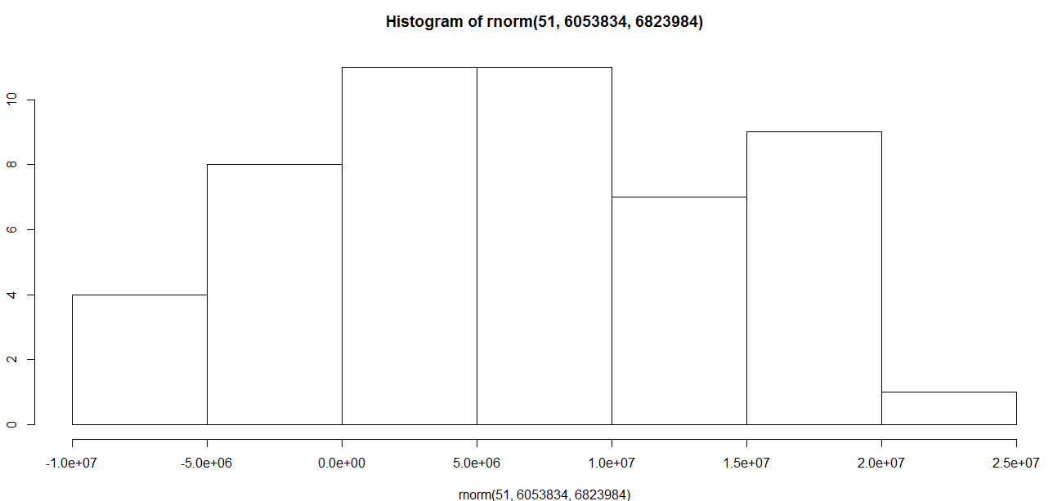

Data Science
So,,,,
Sampling Dist ibution
Key analysis process associated with statistical inference

Slide 24
IST687 – Applied Data Science
End of Chapter
Sample in a Jar

